Slide 1
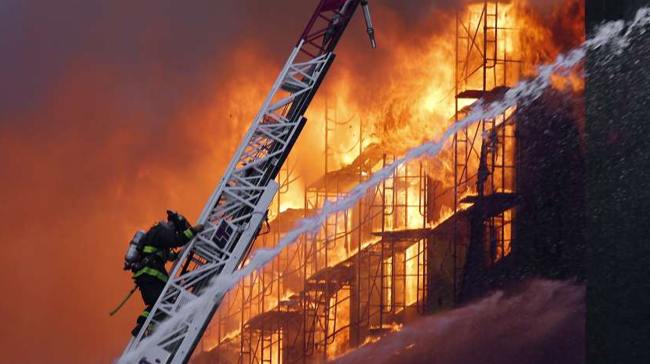
FIRE DEPARTMENT CALL LOG ANALYSIS IN SAN FRANCISCO
Aaditya Alekar
Albert Dabney
Ilavarasan Anbudurai
Nirmal Subramani
Yangyang Jia

Slide 2
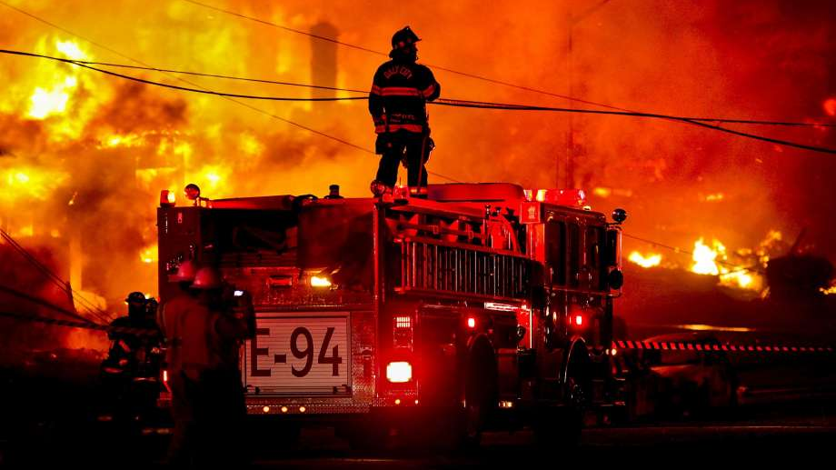
CONTENTS
Introduction
Project Scope
Data Set
Hardware Specifications
Workflow
Queries
Data Visualizations
Summary
Limitations

Slide 3
INTRODUCTION
San Francisco Fire Department (SFFD)
The mission of the Fire Department is to protect the lives and property of the people of San Francisco from fires, natural disasters, and hazardous materials incidents; to save lives by providing emergency medical services; to prevent fires through prevention and education programs. The San Francisco Fire Department was established in 1866 and serves an estimated population of 1.4 Billion people residing in San Francisco
In this project, we focus on analyzing the several incidents that occurred between the year 2000 to 2004, its criticality, priority given to each incident, the units that were involved in resolving each cases, how the incidents have varied over the years in different parts of San Francisco

Slide 4
PROJECT SCOPE
Analysis on 4 years San Francisco’s Fire Department dataset
The dataset obtained was analyzed using Oracle Cloud and HIVEQL
Data in HDFS was accessed using WINSCP
Visualization of the data analysis is done using Tableau

Slide 5







WORK FLOW
WinSCP
Data Logs
Analysis
Visualized Report

Slide 6
DATA SET
Dataset link : https://data.sfgov.org/Public-Safety/Fire-Department-Calls-for-Service/nuek-vuh3
Dataset contains about 4.51Million rows and 34 columns
Dataset mainly comprises of:
Call Id
Incident types
Location details
Format: CSV
Size: 1.7 GB

Slide 7
HARDWARE SPECIFICATION
Oracle Big Data Compute Edition: 5 nodes
OCPUs: 10
Memory: 150 GB
Storage: 678 GB
HDFS Capacity: 147 GB

Slide 8
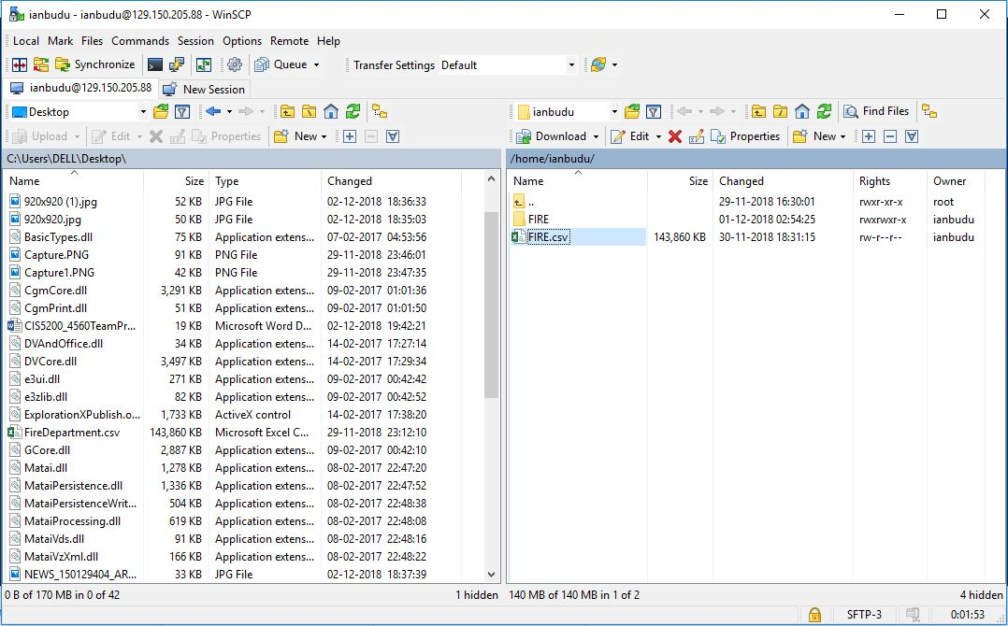
WinSCP

Slide 9
QUERIES USED
DROP TABLE IF EXISTS FIRE;
CREATE EXTERNAL TABLE IF NOT EXISTS
FIRE(Call_Number BIGINT,Incident_Number INT,Call_Type STRING,Call_Date STRING,Call_Final_Disposition STRING,Address STRING,Zipcode BIGINT,Box INT,Priority INT,ALS_Unit STRING,Number_of_Alarms INT,Unit_Type STRING,Neighborhood STRING,Latitude DOUBLE,Longitude DOUBLE)
ROW FORMAT DELIMITED FIELDS TERMINATED BY ','
STORED AS TEXTFILE LOCATION '/user/ianbudu/NIM/FIRE'
TBLPROPERTIES ("skip.header.line.count"="1");

Slide 10
QUERIES USED
CREATE TABLE que1
ROW FORMAT DELIMITED FIELDS TERMINATED BY ','
STORED AS TEXTFILE LOCATION '/user/ianbudu/NIM/que1/'
AS
SELECT count(Call_Number), Call_Date from FIRE where Call_Date IS NOT NULL group by Call_Date;
select * from que1 limit 10;

Slide 11
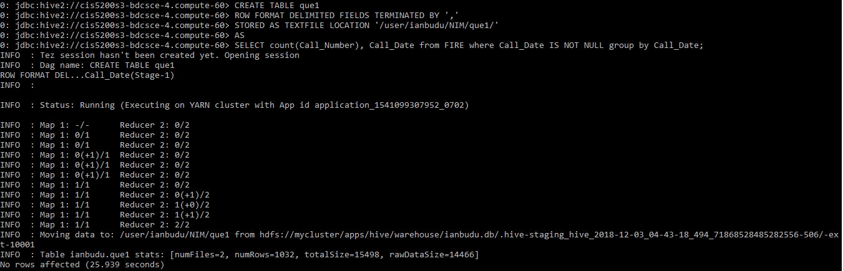
QUERY FOR TABLE CREATION

Slide 12
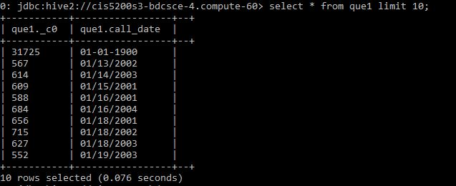
CONTENTS OF THE TABLE

Slide 13
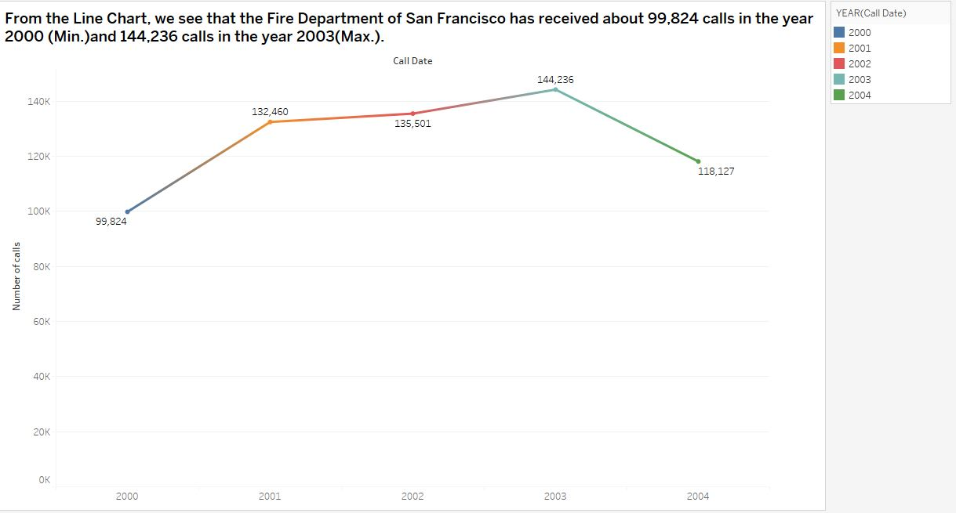
NUMBER OF CALLS REGISTERED BY FIRE DEPARTMENT OVER THE SPAN OF 5 YEARS

Slide 14
NUMBER OF CALLS REGISTERED BY FIRE DEPARTMENT OVER THE SPAN OF 5 YEARS
Maximum Number of calls:
Year 2003
Year 2000
From the Line Chart, we see that the Fire Department of San Francisco has received about 144,236 calls in the year 2003 and 99,824 calls in the year 2001

Slide 15
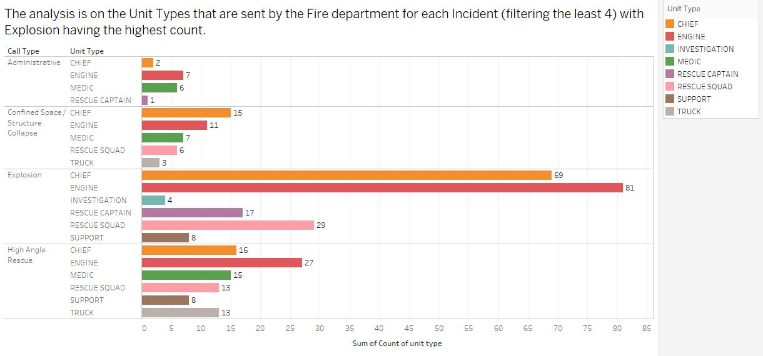
THE NUMBER OF UNITS DISPATCHED ACCORDING TO THE DIFFERENT TYPES OF CALLS REGISTERED

Slide 16
THE NUMBER OF UNITS DISPATCHED ACCORDING TO THE DIFFERENT TYPES OF CALLS REGISTERED
The analysis is on the Unit Types that are sent by the Fire department for each Incident (filtering the least 4). It can be inferred that the Administrative call type requires the least dispatch unit compared to others.

Slide 17
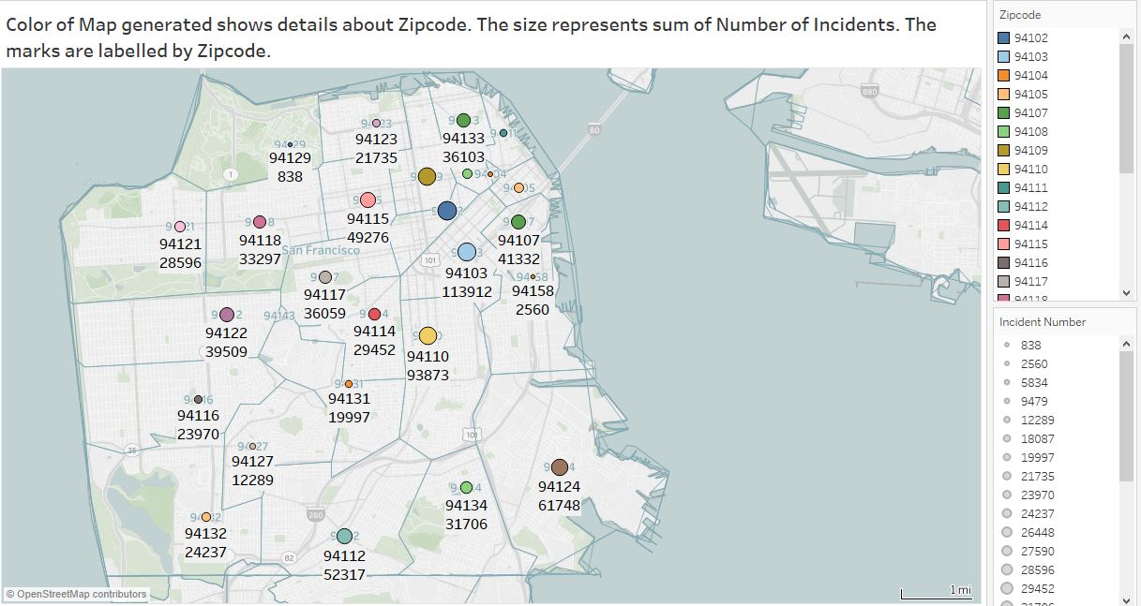
NUMBER OF INCIDENTS LABELLED BY ZIP CODES USING GEO SPATIAL

Slide 18
NUMBER OF INCIDENTS THAT HAPPENDED IN A PARTICULAR ZIP CODE
Zip codes with majority Incidents:
94102
94103
The analysis shows that the majority of incidents occurred in two neighboring zip codes accounting to 113,912 in 94103 and 93,873 incidents in 94110.

Slide 19
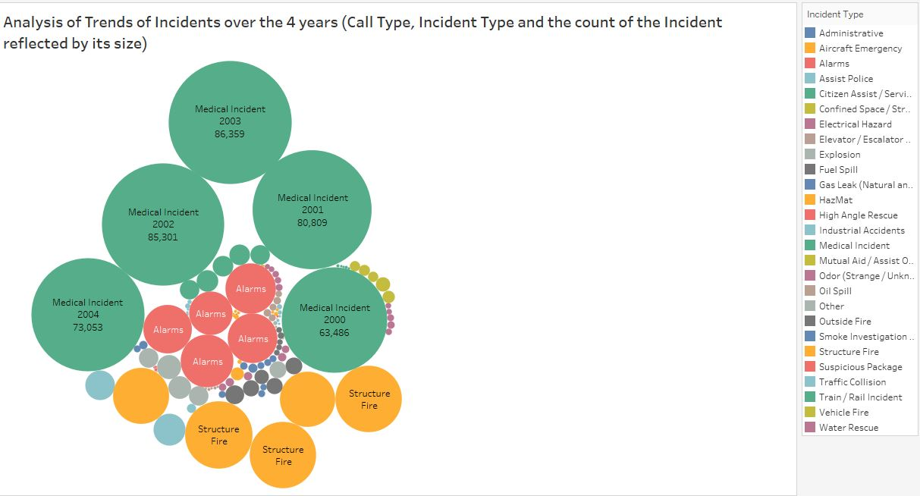
ANALYSIS OF INCIDENTS OVER THE PERIOD OF FIVE YEARS

Slide 20
ANALYSIS OF INCIDENTS OVER THE PERIOD OF FIVE YEARS
Leading reported Incidents:
Medical Incident
Structure Fire
Alarms
The Packed Bubbles chart clearly states that from the year 2000 to 2004 the fire department received calls majorly for three issues, Medical Incidents leading the list.

Slide 21
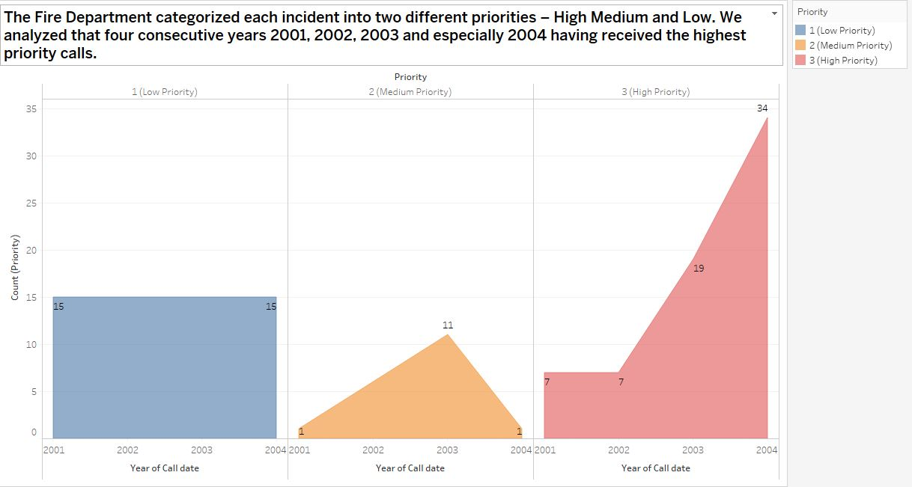
CALL TYPES CATEGORIZED ACCORDING TO LOW AND HIGH PRIORITIES

Slide 22
CALL TYPES CATEGORIZED ACCORDING TO PRIORITIES
1- Low priority
2- Medium priority
3- High priority
The Fire Department categorized each call into three different priorities – Low, Medium and High. We analyzed that low priority calls have remained constant, Medium priority calls had highs and lows, High priority calls varies over the years.

Slide 23
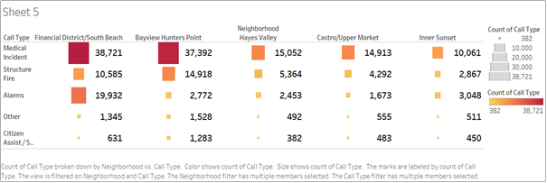
COUNT OF CALL TYPES ACCORDING TO NEIGHBOURHOOD

Slide 24
COUNT OF CALL TYPES ACCORDING TO NEIGHBOURHOOD
Among the various areas/cities in San Francisco, with the help of Heat Map the five major areas to have reported most incidents are Financial District/South Beach, Bayview Hunters Point, Neighborhood Hayes Valley, Castro/Upper Market and Inner Sunset.

Slide 25
Summary
Most calls were received in the YEAR 2003
Administrative incident had the least requirement for dispatch units from San Francisco Fire Department
Most incident prone areas are of zipcodes 94102, 94103 and 94109
Medical Incident was observed to see highest no of count
Low priority calls have remained constant, Medium priority calls had highs and lows, High priority calls varies over the years.
Five major areas to have reported most incidents are Financial District/South Beach, Bayview Hunters Point, Neighborhood Hayes Valley, Castro/Upper Market and Inner Sunset.

Slide 26
LIMITATIONS
The Analysis of the Dataset revolved around different Incident types due to Limited parameters.
The dataset should have been more specific i.e. it should have more information pertaining to the actual cause of the incident, it would have been possible to analyze and infer the major reasons for the incident and provided a solution
Certain incidents could be done as crimes too, had the data about incident caused by crimes be given, we could have analyzed the crimes that cause the incidents
Had the data about damage been specified , we would have been able to analyze each incident in depth
The data set should have included the correct count of People injured in each incident in the particular area or zipcode

Slide 27
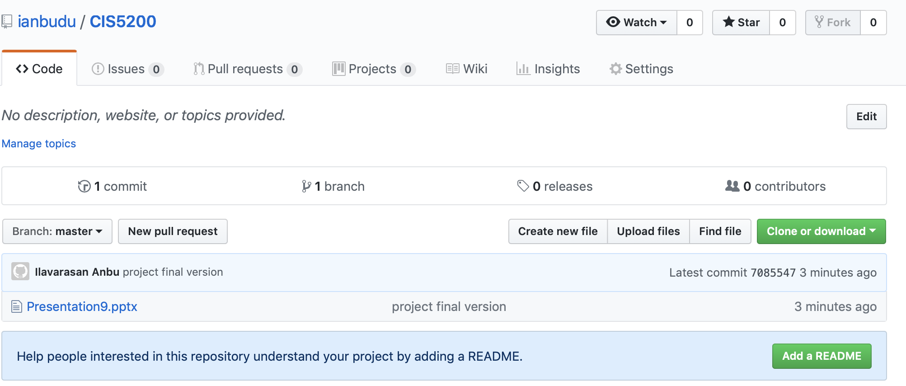
GitHub
GitHub Link: https://github.com/ianbudu/CIS5200

